Slide 1

Credit Card Data Analysis: Unlocking Financial Insights
Credit card transactions produce vast amounts of data. Analyzing this can identify trends and improve financial strategies. Our goal is to analyze credit card usage, customer spending, and potential risks.

Slide 2
Data Sources and Approaches
Data Sources and Base
Approaches Used
DAX Implementations
Transactional data from credit card purchases
Data cleaning and transformation using Power BI
Measures for total spending and average transaction value
Customer demographic details
Aggregation and filtering for meaningful insights
Customer segmentation
Week intelligence function for trend analysis

Slide 3
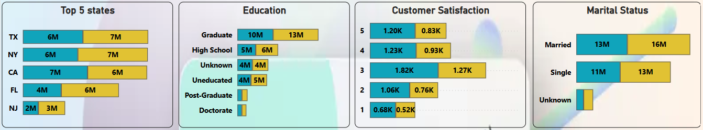
Enhancements and Modifications
Visual Elements
Interactive Filtering
Enhanced charts, tables, and KPIs for clear presentation.
Applied slicers for filtering by demographics and spending.
Custom Measures
Added calculated columns to refine insights.

Slide 4




High-Spending Customers
High-spending customers significantly boost revenue.
Targeted promotions can enhance customer loyalty.
Customized offers drive increased spending.

Slide 5





Seasonal Spending Trends
Winter
Increased spending on holiday gifts and travel.
Spring
Spending on home improvements and vacations.
Summer
Outdoor activities, travel, and entertainment spending.
Autumn
Back-to-school shopping and early holiday planning.

Slide 6



Risk Management and Anomaly Detection
2
Transaction Monitoring
1
Spending Alerts
Anomaly Detection
3
These insights help optimize credit limits and minimize defaults. Data-driven decisions improve financial health.

Slide 7



Optimizing Credit Limits
1
Maximize Profit
2
Reduce Defaults
3
Data Insights
Data insights optimize credit limits and minimize defaults. Data-driven decision-making improves financial health and customer engagement.

Slide 8

Key Takeaways and Next Steps
1
Data-Driven Decisions
2
Customer Engagement
Improve financial health using data insights.
Enhance loyalty with targeted promotions.
3
Risk Mitigation
Optimize credit limits and minimize defaults.

